Slide 1
Economic Analysis of Ecosystem Services:
The UK Experience
Ian Bateman
Head of Economics for the UK National Ecosystem Assessment
Ian J. Bateman, David Abson, Nicola Beaumont, Amii Darnell, Carlo Fezzi, Nick Hanley, Andreas Kontoleon, David Maddison, Paul Morling, Joe Morris, Susana Mourato, Unai Pascual, Grischa Perino, Antara Sen, Dugald Tinch, Kerry Turner, Gregory Valatin, Barnaby Andrews, Viviana Asara, Tom Askew, Uzma Aslam, Giles Atkinson, Nesha Beharry-Borg, Katherine Bolt, Murray Collins, Emma Comerford, Emma Coombes, Andrew Crowe, Steve Dugdale, Jo Foden, Steve Gibbons, Roy Haines-Young, Caroline Hattam, Mark Hulme, Tiziana Luisetti, George MacKerron, Stephen Mangi, Dominic Moran, Paul Munday, James Paterson, Guilherme Resende, Gavin Siriwardena, Jim Skea, Daan van Soest, Mette Termansen.
Presentation to:
Wealth Accounting and Valuation of Ecosystem Services (WAVES) Partnership Meeting
The World Bank, Washington DC
29-31 March, 2011
THIS PRESENTATION DOES NOT NECESSARILY REPRESENT THE FINDINGS OR VIEWS OF THE
UK NATIONAL ECOSYSTEM ASSESSMENT
Centre for Social & Economic Research on the Global Environment

Slide 2
UK National Ecosystem Assessment (NEA): Overall Conceptual Framework
Drivers of Change
Environmental change (e.g. rainfall, sea level)
Trends (e.g. markets, preferences, demographics)
Policies
Social Feedbacks
Future
Scenarios for the UK
Human
wellbeing
Ecosystem services
Values
Social (‘cultural’)
Provisioning
Regulating
Supporting
Goods
Ecosystems
Biodiversity & physical inputs

Slide 3
Cultural
From ecosystem services to their value
Millennium Assessment categories
Provisioning
Regulating
Other capital
inputs
Supporting
Physical and chemical inputs
ES contribution to well-being
Primary & intermediate processes
Final ecosystem
services
Value of goods...
..of which ES value
Non-monetised
Goods
£
£
☺
Weathering
Crops, livestock, fish
Food
☺
Water availability
Drinking water
£
£
☺
Primary production
Trees
Fibre
£
£
☺
Decomposition
Peat
£
£
Energy
☺
Soil formation
Wild species diversity
£
£
+
☺
Nutrient cycling
Equable climate
£
£
☺
Waste breakdown
Pollution control
£
£
☺
Water cycling
Detoxification
Flood control
£
£
☺
Purified water
☺
Climate regulation
Local climate
£
£
Disease control
£
£
☺
Pollination
Stabilising vegetation
☺
Natural enemies
Natural medicine
£
£
£
£
☺
Evolutionary processes
Recreation
☺
Meaningful places
£
£
Ecological interactions
Wild species diversity
Good health
☺
£
£

Slide 4
Integrated modelling
Natural environment
Climate change
Market
Policy
Farm decisions & income (£)
Land use
Water environment
ES value of water (£)

Slide 5
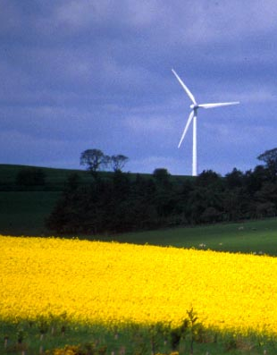
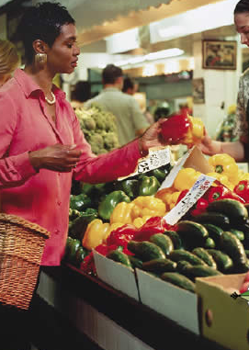
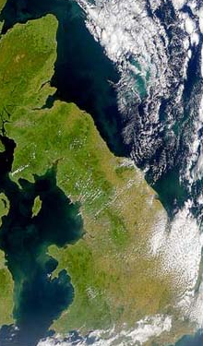
The main drivers of land use change
MARKETS & TECH
POLICY
ENVIRONMENT
Set aside rate
Output prices
Soils
NVZ, ESA, Parks, etc.
Input costs
Temperature
Milk quota
Technology
Rainfall

Slide 6
Data
We assemble Agricultural Census data for every 2km grid square, for all of England and Wales from 1969 to 2004 and combine this with over 50,000 farm years of data from the Farm Business Survey. This gives:
Agricultural land use hectares (wheat, barley, grass, etc.);
Livestock numbers (dairy, beef, sheep, etc)
Time trends (response times, new crops, etc.)
We then add
Environmental and climatic variables (rainfall, temperature, machinery working days, field capacity, etc.);
Policy determinants (NVZ, NSA, ESA, Parks, etc.)
Input and output prices for the period

Slide 7
Modeling land use decisions
Based on a joint (in inputs) multi-activity farm profit function
Profits = f (output price, input price; farm size; farm physical environment; etc.)
Cereals
Oilseed rape
Root crops
Temporary grassland
Permanent grassland
Rough grazing
Dairy cattle
Beef cattle
Sheep
Other farm land (farm woodland, etc.)
> 88% of total agricultural land
Activities modelled:

Slide 8
Variable | Coefficient
Price_{cereals} | 0.134 ***
Price_{fertilizer} | -0.111 ***
Set aside rate | -0.425 ****
ESA share | -0.033 ****
Park share | -0.019 ***
Urban share | -0.028 **
Slope > 6º | -0.087 ***
Coastal (dummy) | -0.357
Elevation | 14.170 ****
Elevation squared | 6.333 ***
Mach. work days (MWD) | 4.174 ****
MWD² | -1.283 ***
Pot. evapotranspiration (PT) | 6.727 ***
PT² | -2.773 **
Field capacity (FC) | -4.794 *
FC² | 16.670 ***
Degree days (DD) | -4.228 ***
DD² | 2.571 **
Av rainfall (AAR) | -3.726
AAR² | -1.269
Trend | 0.015
Constant | 38.040****
The area of cereals is a function of:
Market forces
Policy
Local physical environment and environmental change

Slide 9
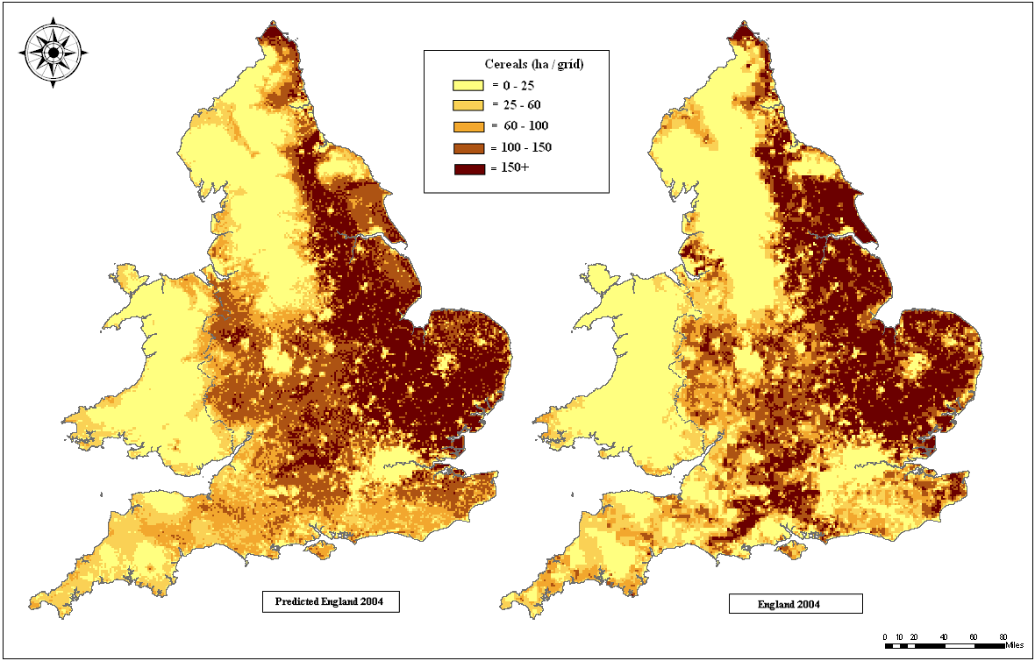
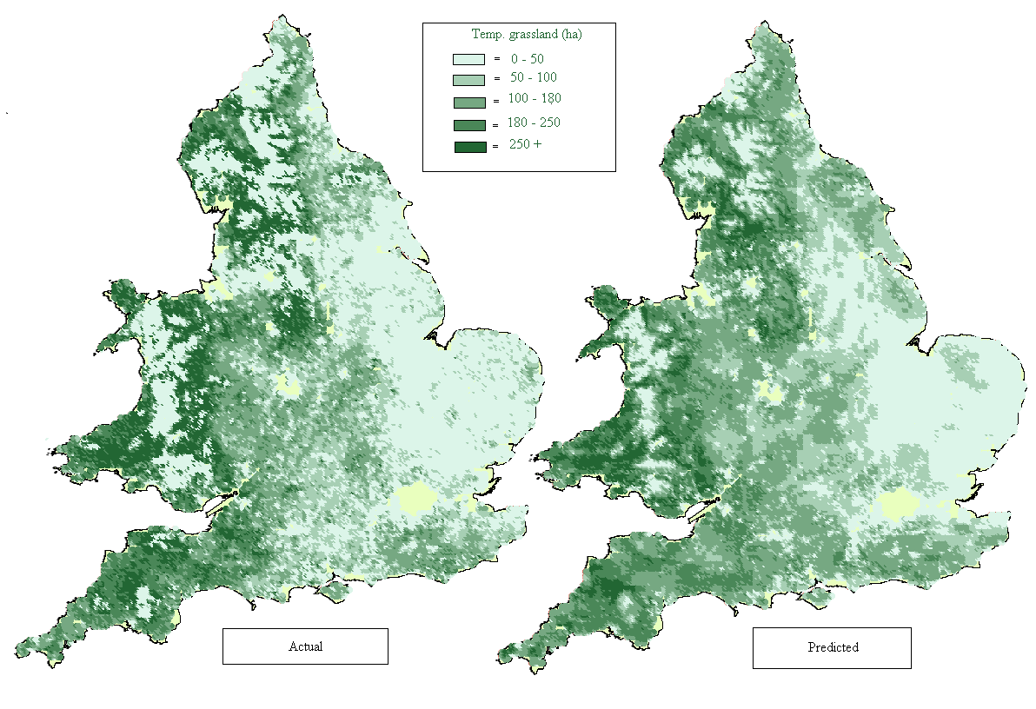
Validation: Actual versus predicted tests
Cereals
Temporary grassland

Slide 10
Predicting other land uses
Notes:
10

Slide 11
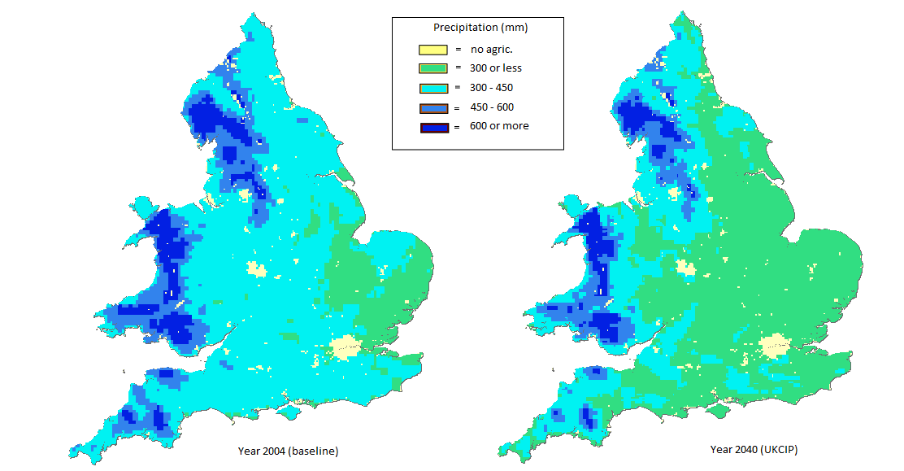
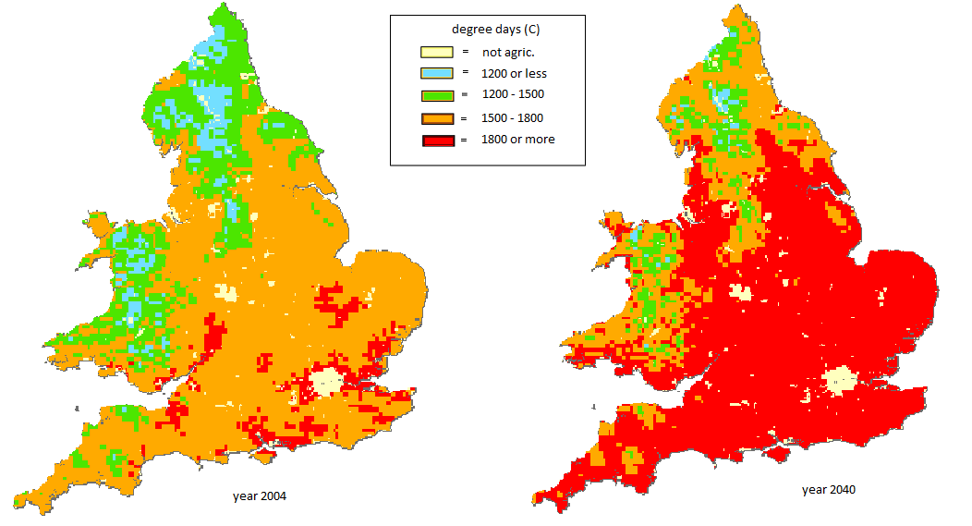
Climate change impacts
Rainfall: 2004 - 2040
Temperature: 2004 - 2040

Slide 12
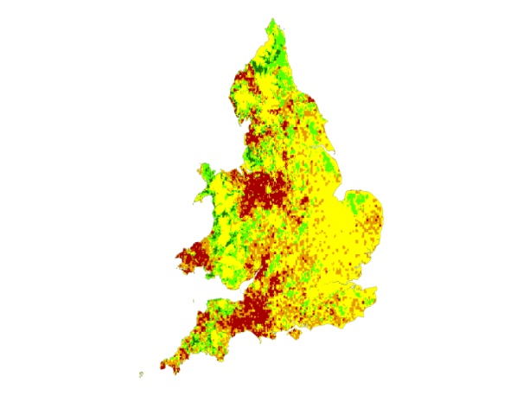
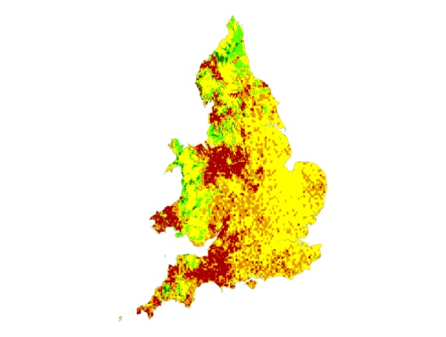
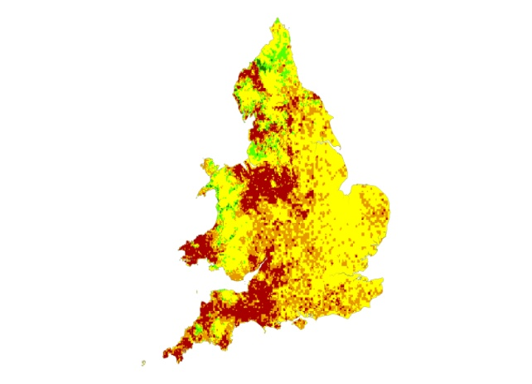
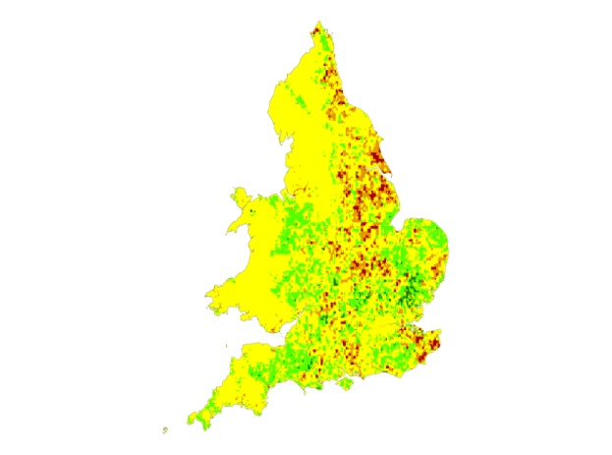
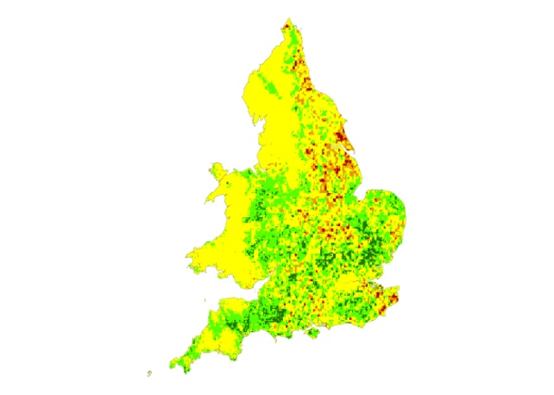
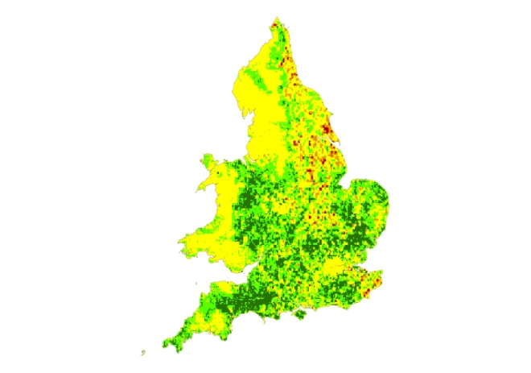
Predicted land use changes due to climate change:
e.g. Dairy vs. Oilseed rape
Dairy
2004-2020
2004-2040
2004-2060
-710 - -100
-100 - -20
-20 - 20
20- 80
80- 200
Oilseed rape
2004-2020
2004-2040
2004-2060
-400 - -30
-30 - -12
-12 - 12
12- 30
30- 70

Slide 13
Predicted change in farm gross margin due to climate change 2004-2050
UKCIP low emissions scenario
UKCIP high emissions scenario

Slide 14
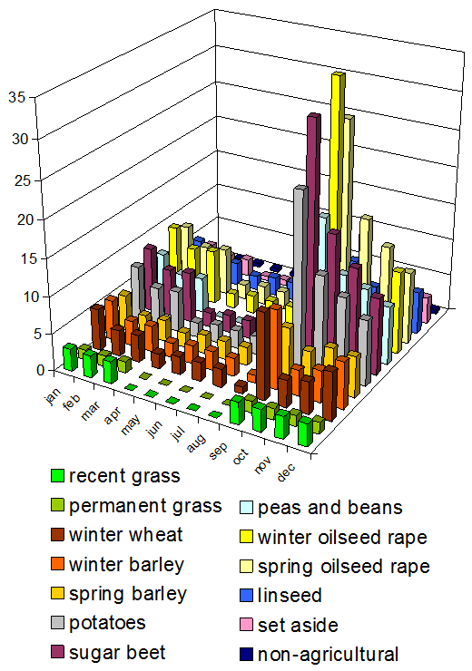
Land use change & water quality
Nitrate leaching per month
Integrated modelling: Linking land use with diffuse water pollution
Modelling the impacts of land use change on river water quality and ecosystems services
- and how water policies like WFD forces land use to change
Notes:
14

Slide 15
What reduces chlorophyll-a concentrations in rivers?
Less root crops
Less dairy cows
Less suspended sediment
Higher river flows
Lower water temperature
Higher rainfall
But do the public value changes in river water quality?
And if so....by how much?

Slide 16
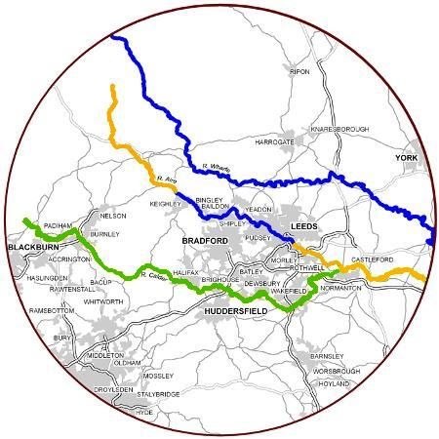
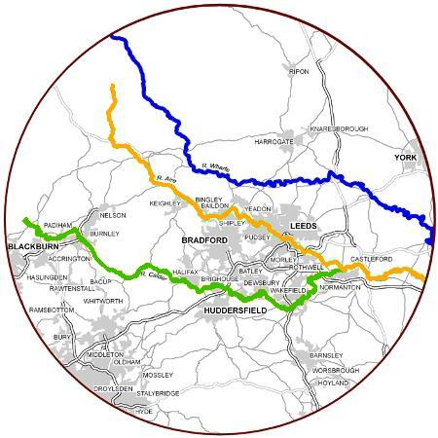
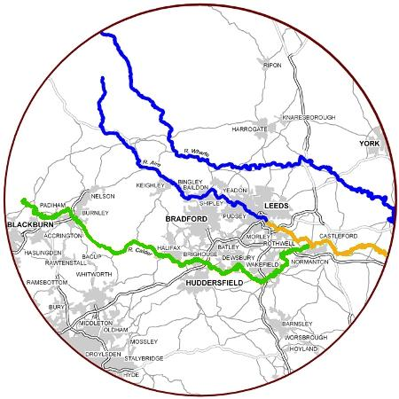
Valuation methods 1: Stated preference (contingent valuation; choice experiments; etc.)
STATUS QUO
ALTERNATIVE
(improvement B)
(improvement A)
SAME WATER BILL
WATER BILL + £ X
Looking at more than one change shows how the value of each successive improvement diminishes. This avoids overstating the value of multiple improvements
Spatially dispersed sampling to capture real world variation in the availability and quality of the improvement site and substitutes

Slide 17
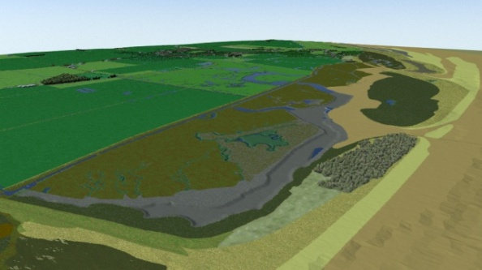
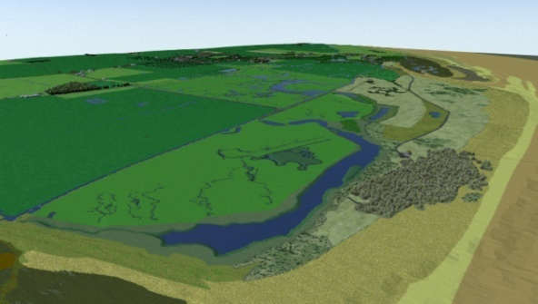
Valuation methods 1: Stated preference (contingent valuation; choice experiments; etc.)
Enhancing understanding using virtual reality
Which do you prefer?
No change in water bill
£ X increase in water bill
Notes:
17

Slide 18
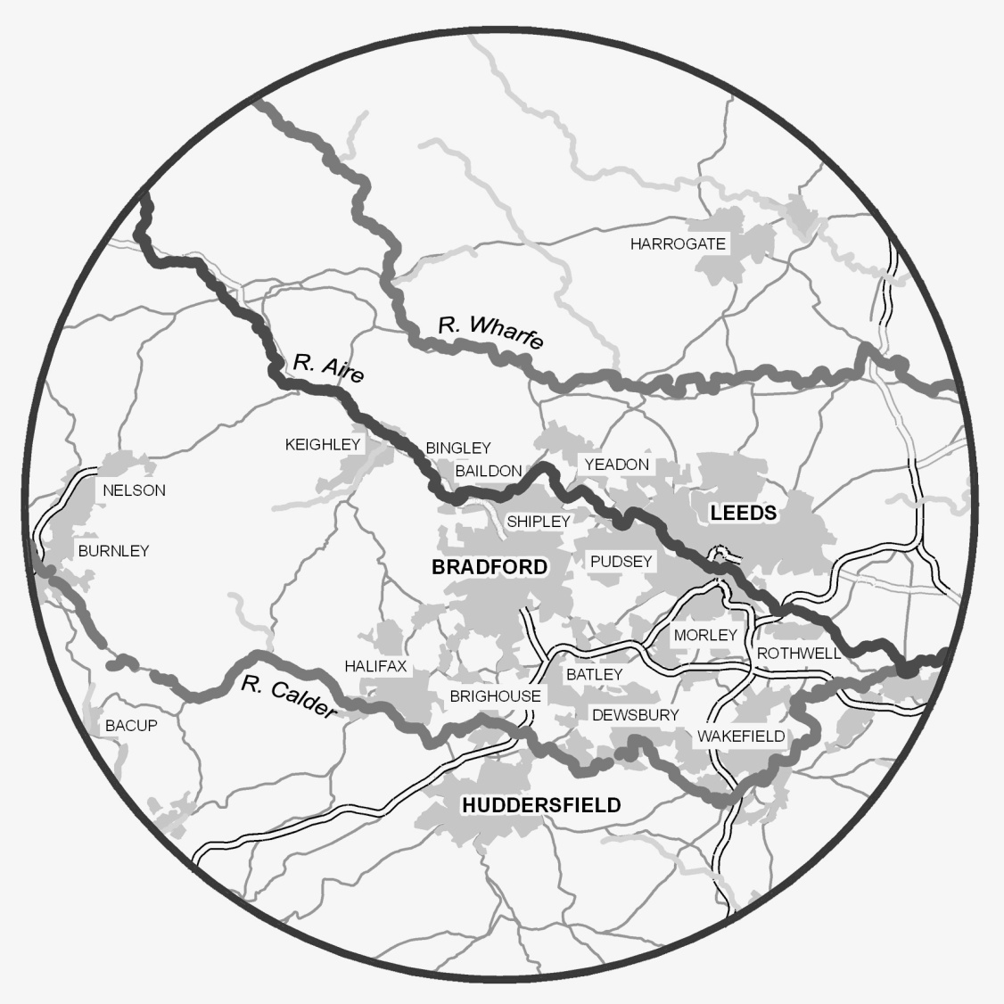
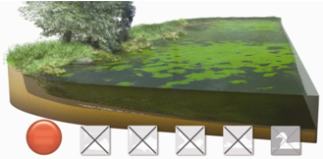
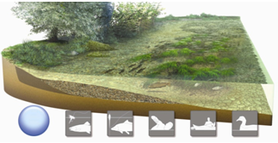
Valuation methods 2: Revealed preference
Valuing water recreation
Survey of a diverse sample of over 2,000 households across a wide area with variable water quality (enhances transferability)
For each respondent: Home located
Locate visited sites
Characterise water quality (e.g. EA data)
Record visit frequency
Identify all possible sites (including zero visit sites)
GIS generated measures of travel time
Travel cost model of the trade-off between visit frequency, visit cost and water quality
Estimate the value individuals have for changes in water quality
(8 visits)
(1 visit)
(1 visit)
(4 visits)
(1 visit)
£
Notes:
18

Slide 19
What encourages people to visit rivers?
Near to home
Other tourist attractions on site
Nearby pubs and car parks
Far from sewage works and industry
Few other substitutes available
And...
High water quality

Slide 20
Marginal WTP
Water quality
(WFD categories)
Red
(dreadful)
Yellow
(poor)
Green
(good)
Blue (pristine)

Slide 21
Integrated modelling case study
2. Combating land use change impacts on water quality
 | Baseline | 20% Fertiliser reduction | 20% Livestock reduction | 20% switching arable
Load (kg/ha) | 24.9 | -1.1 (-4%) | -1.5 (-6%) | -5.5 (-22%)
Concentration (mg/L) | 5.4 | -0.2 (-4%) | -0.3 (-6%) | -1.2 (-21%)
Farm income lost (£m) |  | -2.39 [-2.50;-2.27] | -1.89 [-2.00 ; -1.79] | -5.53 [-5.23;-5.84]
Effectiveness (£m L /mg) |  | -11.3 | -6.3 | -4.7

Slide 22
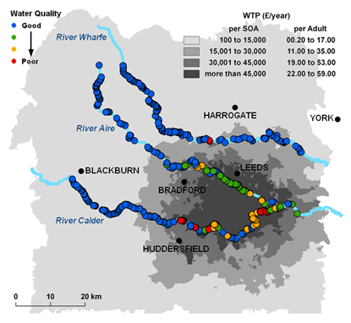
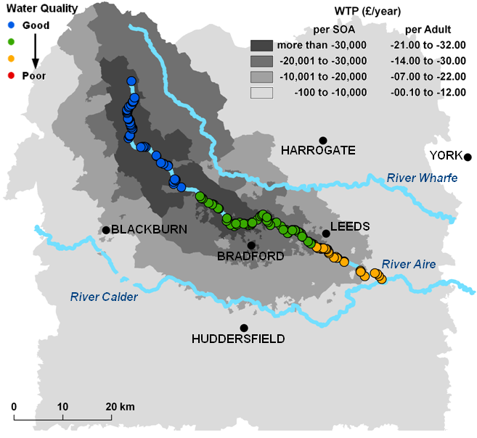
Spatial distribution of water quality change values
Climate change disutility
WFD improvements
Scenario | Climate change | WFD (urban only) | WFD (all popn.)
Total value for area p.a. | - £6.7 million | + £12.5 million | + £7 million

Slide 23
www.valuing-nature.net
Founding partners and funders

Slide 24
Economic Analysis of Ecosystem Services:
The UK Experience
Ian Bateman
Head of Economics for the UK National Ecosystem Assessment
Ian J. Bateman, David Abson, Nicola Beaumont, Amii Darnell, Carlo Fezzi, Nick Hanley, Andreas Kontoleon, David Maddison, Paul Morling, Joe Morris, Susana Mourato, Unai Pascual, Grischa Perino, Antara Sen, Dugald Tinch, Kerry Turner, Gregory Valatin, Barnaby Andrews, Viviana Asara, Tom Askew, Uzma Aslam, Giles Atkinson, Nesha Beharry-Borg, Katherine Bolt, Murray Collins, Emma Comerford, Emma Coombes, Andrew Crowe, Steve Dugdale, Jo Foden, Steve Gibbons, Roy Haines-Young, Caroline Hattam, Mark Hulme, Tiziana Luisetti, George MacKerron, Stephen Mangi, Dominic Moran, Paul Munday, James Paterson, Guilherme Resende, Gavin Siriwardena, Jim Skea, Daan van Soest, Mette Termansen.
Presentation to:
Wealth Accounting and Valuation of Ecosystem Services (WAVES) Partnership Meeting
The World Bank, Washington DC
29-31 March, 2011
THIS PRESENTATION DOES NOT NECESSARILY REPRESENT THE FINDINGS OR VIEWS OF THE
UK NATIONAL ECOSYSTEM ASSESSMENT
Centre for Social & Economic Research on the Global Environment

